Slide 1
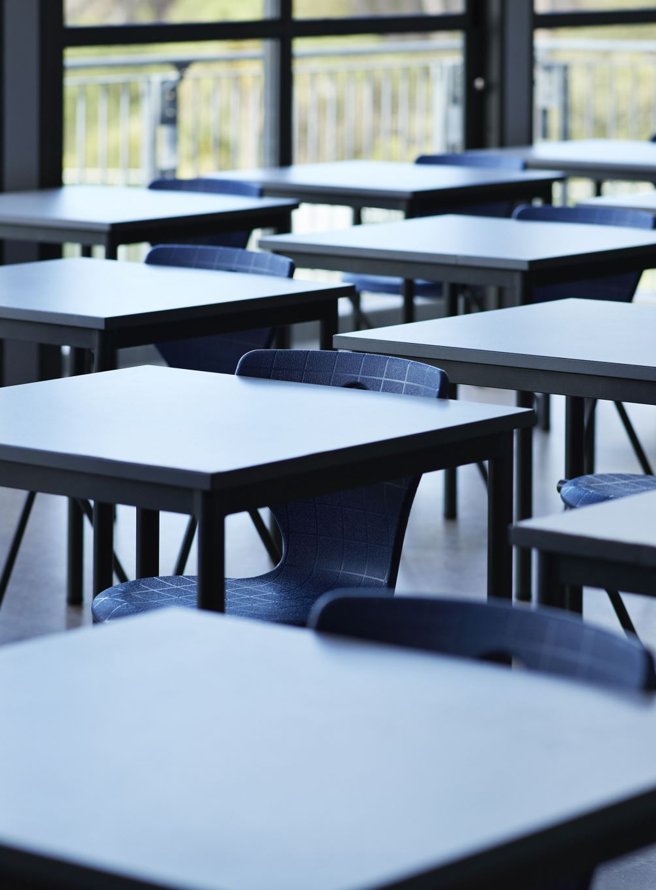
Student GroupS Allocation
By,
Karthik Badiganti
Sai Rohan Paritala
Shravan Sobhani
Pratheek Sreerangam

Slide 2

Problem Statement
A Class consists of 12 students. We need to form 4 groups with 3 students in each group. Our goal is to maximize the chance of each group to have success.

Slide 3
Parameters Considered
GPA
Grade in Scale of 1-4
Experience
Experience in years
Presentation Skills
Rating from 1-10
Success Ratio S = 50%(GPA)+30%(Experience)+20%(SKILLS)

Slide 4
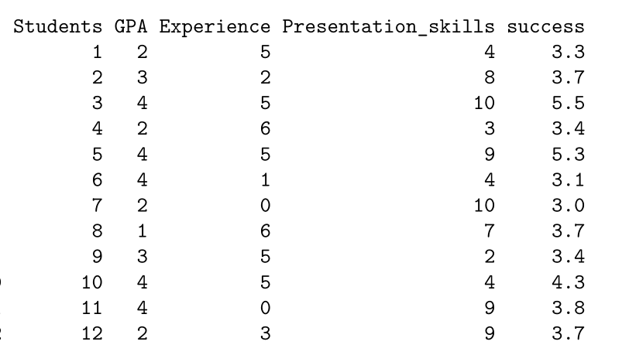

Slide 5

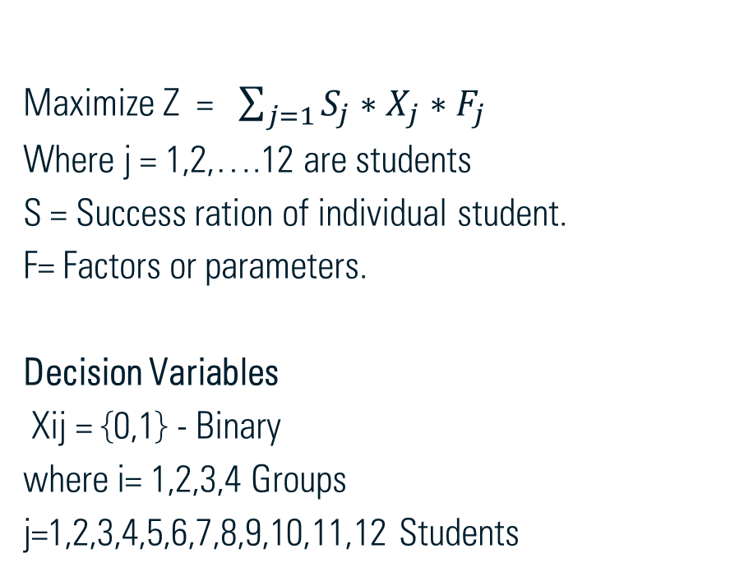
Objective formulation
Maximize Z = $\sum_{j=1}{S_{j}∗X_{j}∗F_{j}}$
Where j = 1,2,….12 are students
S = Success ration of individual student.
F= Factors or parameters.
Decision Variables
Xij = {0,1} - Binary
where i= 1,2,3,4 Groups
j=1,2,3,4,5,6,7,8,9,10,11,12 Students

Slide 6
Assumed Constraints
Each group should have only 3 members Experience
Total GPA of group should be at least 5
Total Experience in group should be at least 5 years
Each group has equal success ratio
Total Skill rating in group should be at least 11
Assuming all variables are binary

Slide 7
Method Used
It is a LP model problem; hence we are solving LP model using lpsolve package in R.

Slide 8
Results
Group 1 Students- 4,7,12
Group2 Students - 2,3,9
Group3 Students - 5,8,10
Group4 Students - 1,6,11

Slide 9
Conclusion
From Solving the model, we found that,
Group 1 has been maximized to success of 9.5
Group 2 with 9.4
Group 3 with 9.3
Group 4 with 9.4
Hence, we can say that the grouping of students has achieved maximum success in each group with slight variation of 0.1

Slide 10

Thank You

